Slide 1
My SQL

Slide 2
Triggers

Slide 3
Triggers are the SQL codes that are automatically executed in response to certain events on a particular table.
Triggers

Slide 4
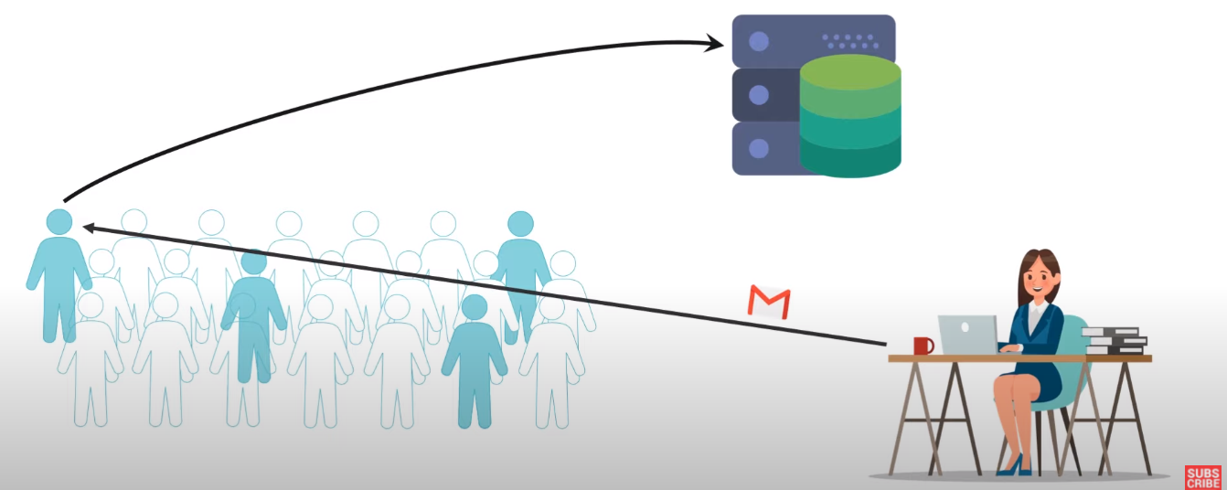

Slide 5
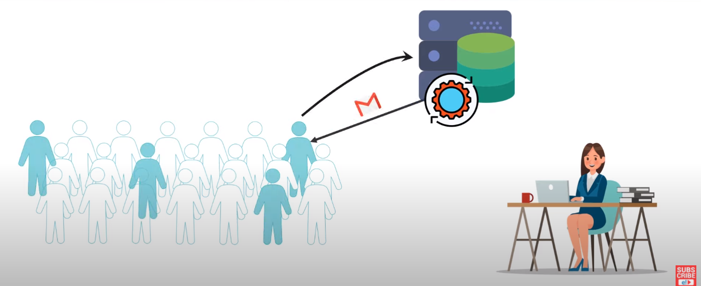

Slide 6
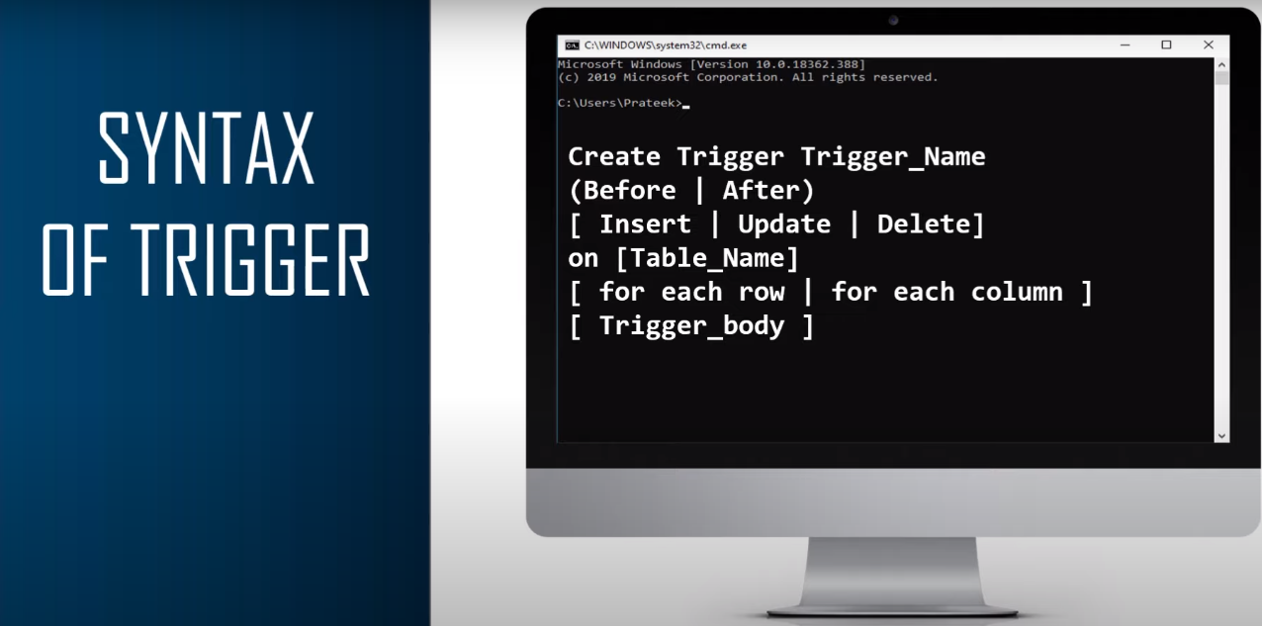

Slide 7
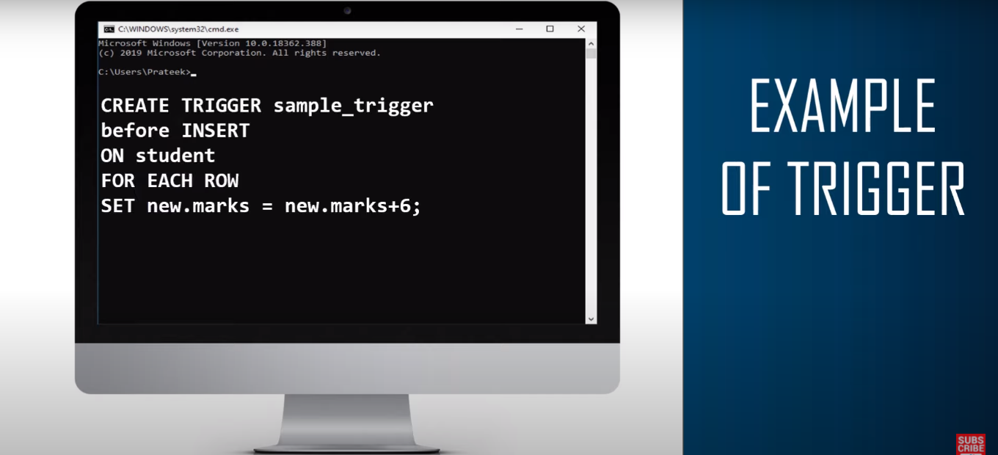

Slide 8
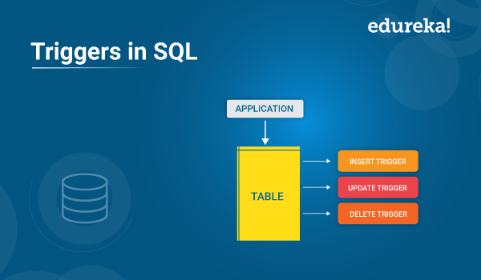

Slide 9
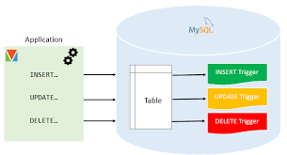
Types of Triggers
After Delete
Before Delete
In My SQL after delete trigger can also be created. After Delete trigger means trigger will invoke after the record is deleted.
3
3
In My SQL before delete trigger can also be created. Before Delete trigger means trigger will invoke before the record is deleted.
After Update
Before Update
In My SQL after update trigger can also be created. After update Trigger means Trigger will invoke after the record is updated.
2
2
In My SQL before update trigger can also be created. Before update Trigger means Trigger will invoke before the record is updated.
After Insert
Before Insert
After trigger can also be created in My SQL. After trigger means, Trigger will invoke after the record is inserted.
1
1
Before trigger can also be created in My SQL. Before trigger means, Trigger will invoke before the record is inserted. .

Slide 10
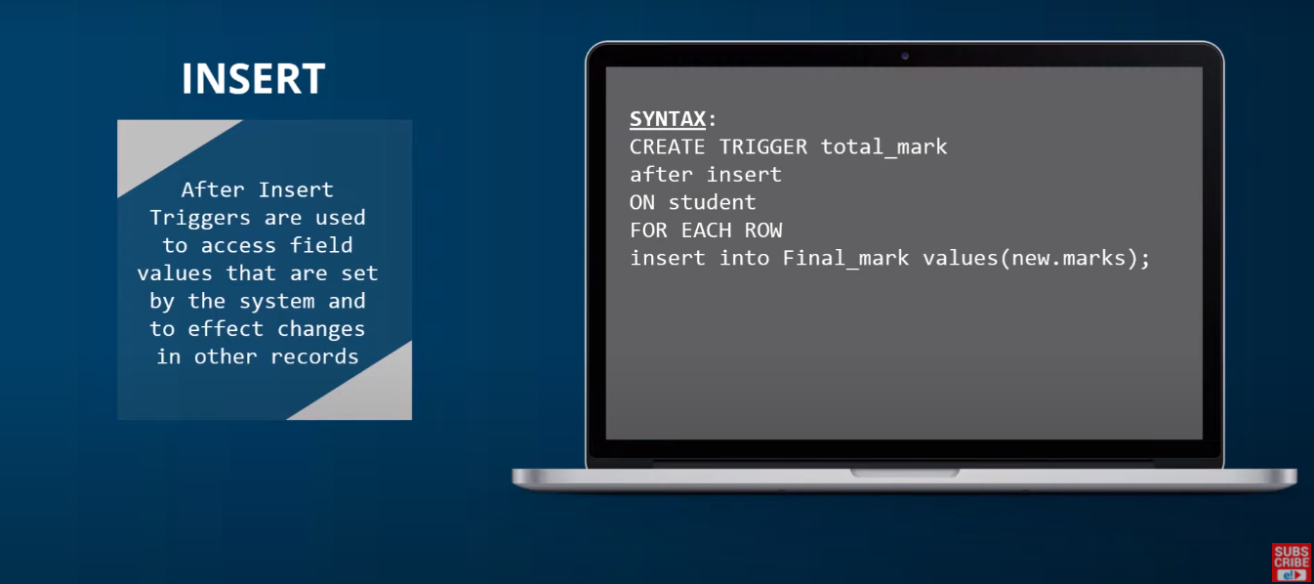
after insert

Slide 11
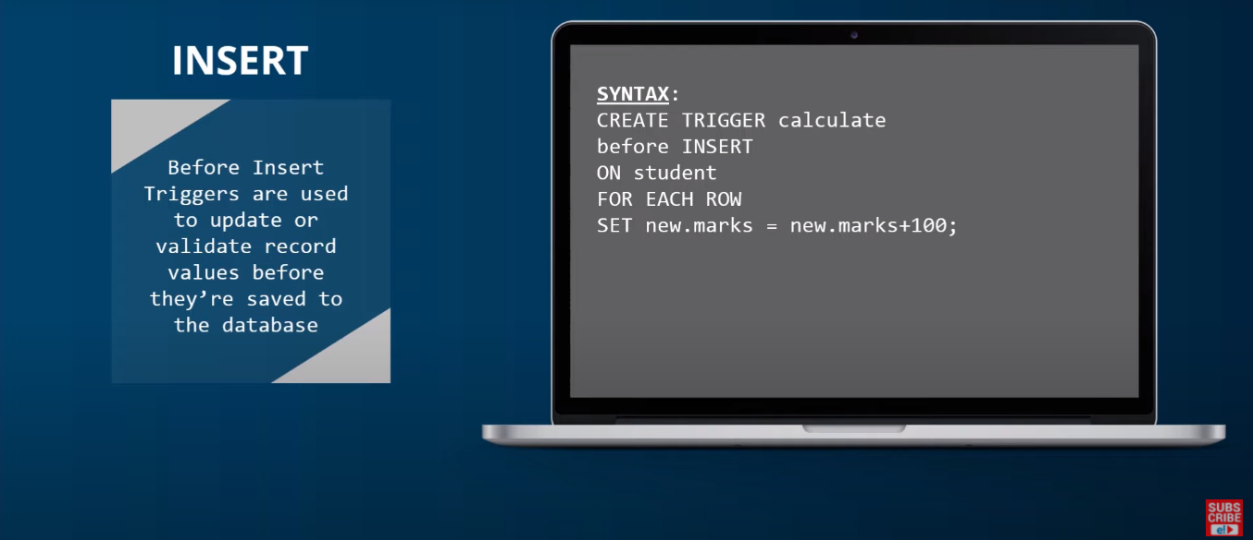
before insert

Slide 12
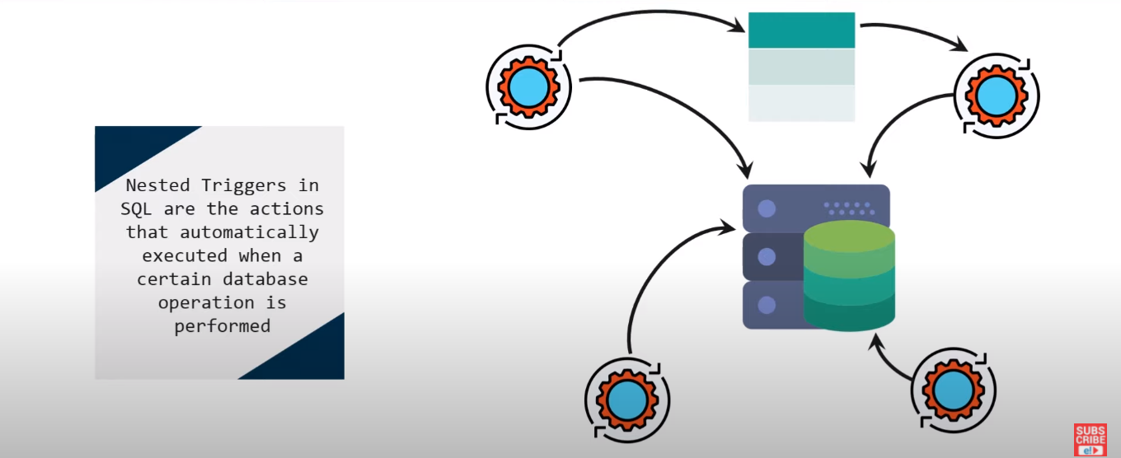
Nested Triggers
You can simply impress your audience and add a unique zing and appeal to your Presentations. Easy to change colors, photos.
You can simply impress your audience and add a unique zing and appeal to your Presentations. Easy to change colors, photos.
ALLPPT Layout Clean Text Slide for your Presentation. ALLPPT Layout Clean Text Slide for your Presentation.
You can simply impress your audience and add a unique zing and appeal to your Presentations. Easy to change colors, photos.
You can simply impress your audience and add a unique zing and appeal to your Presentations. Easy to change colors, photos.

Slide 13
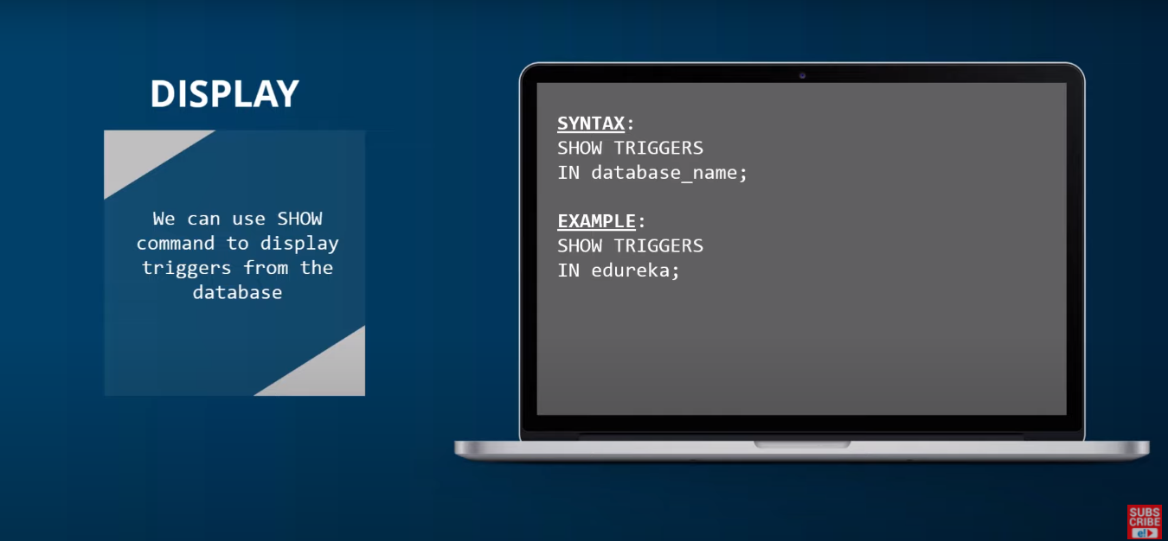
Display

Slide 14
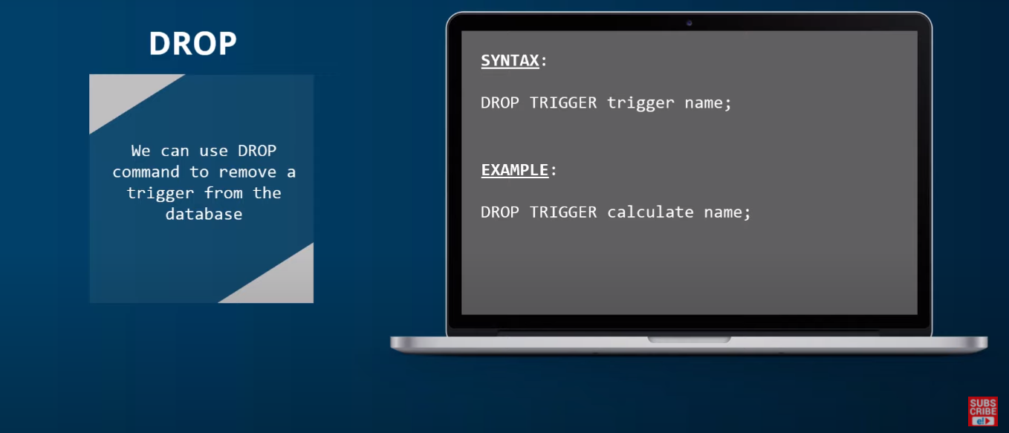
DROP Trigger

Slide 15
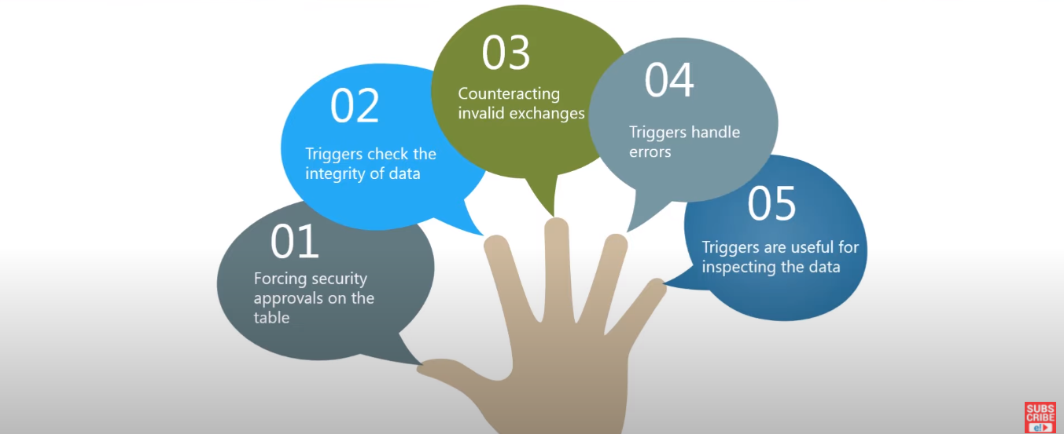
advantages of triggers

Slide 16
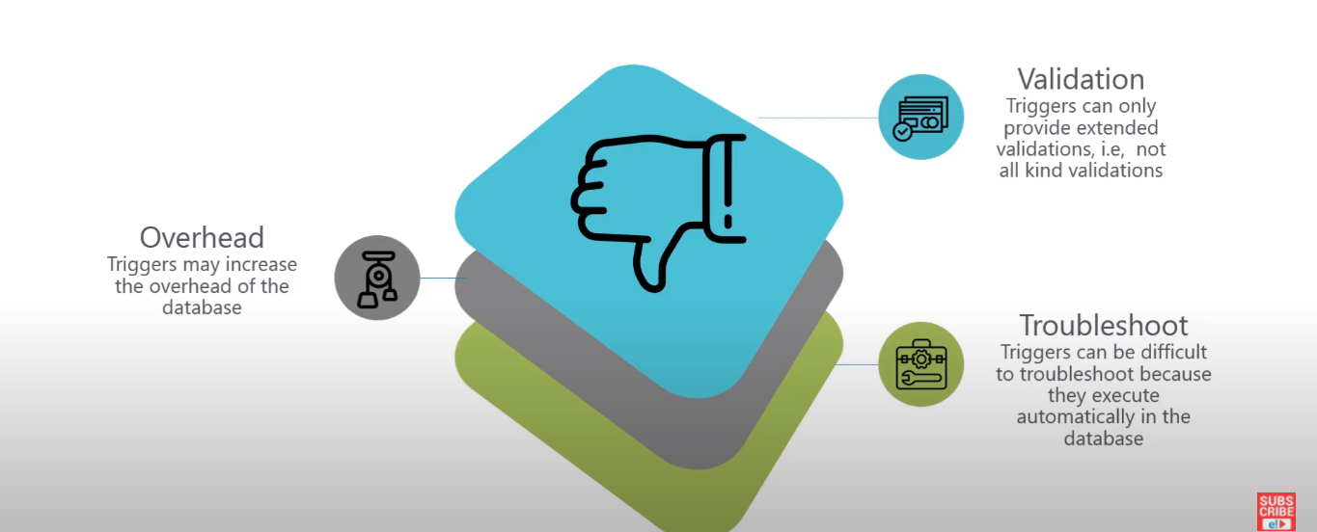
Disadvantages of triggers

